Slide 1
KIGALI IKINDEPENDENT UNIVERSITY
Module: Computer architecture and hardware maintenance
Module code: CSM107
Lecturer : Kwizera Jean Pierre
Cell phone : 0785520535
E-mail : kwijpeter01@gmail.com

Slide 2
Chapter 3: MICROPROCESSOR

Slide 3
Introduction
The microprocessor is one component of the microcomputer.
A microcomputer is a computer similar to any other computer, except that the CPU functions of the microcomputer are performed by the microprocessor.
Similarly, the term peripheral is used for input/ output devices; however, occasionally memory is also included in this term. The various components of the microcomputer and their function are described in the following paragraphs.

Slide 4
The microprocessor is capable of performing computing functions and making decisions to change the sequence of program execution.
In large computers, the CPU performs these computing functions and it is implemented on one or more circuit boards.

Slide 5
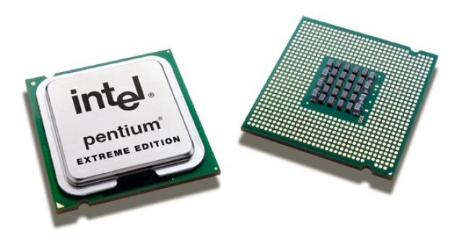

Slide 6
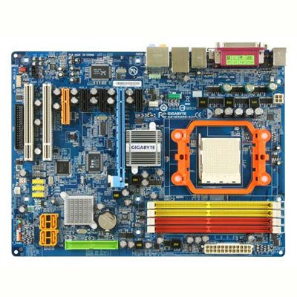

Slide 7
Microprocessor architecture
The microprocessor or a Central Processing Unit CPU is a brain of any normal computer whether it is a personal computer, server or a laptop.
The Central Processing Unit (CPU) is responsible for interpreting and executing most of the commands from the computer's hardware and software.
The CPU is one of the most important elements of the computer.
A microprocessor -- also known as a processor, a CPU or Central Processing Unit

Slide 8
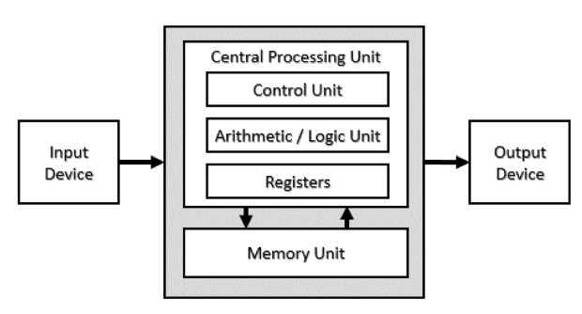

Slide 9
CPU contains three basic components as shown in the figure below:

Slide 10

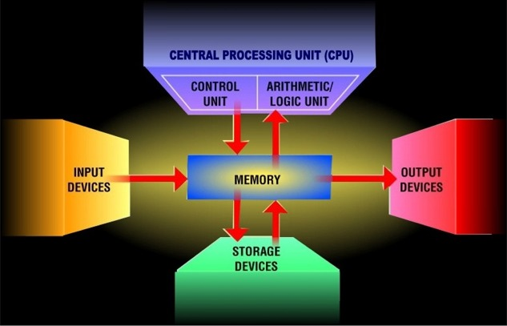
Central Processing Unit
What is a CPU?
What is the central processing unit (CPU)?
Interprets and carries out the basic instructions that operate a computer
Most devices communicate with the CPU in order to carry out a task

Slide 11
The CPU is the main chip in a computer.
It’s as being the brain of the computer.
It controls and co-ordinates the operations of the computer system.
It processes instructions, performs calculations and manages the flow of information through a computer system.
The CPU communicates with the input, output and storage devices to perform tasks. (BIOS) Basic input output system.
Performs: all of the computational operations and the coordination of the usage of resources of a computer.

Slide 12
Arithmetic/Logic Unit (ALU)
The arithmetic and logic unit is the location within which all arithmetic and logical operations are carried out in the CPU.
The Arithmetic/Logic Unit (ALU) performs both arithmetic and logical operations requested by the program.
Arithmetic operations are fundamental math operations like addition, subtraction, multiplication, and division.

Slide 13
Logic operations are based on the computer’s capacity to compare two or more values. For example, it may compare whether a piece of data is greater than or less than, equal to or not equal to etc.
Logical operations such as the AND, OR, and XOR are used to make comparisons and decisions, and these determine how a program is executed.
In order for the ALU to be able to process data, it has special temporary storage locations called registers, which hold the data just before processing.
Registers also hold the results after processing.

Slide 14
The control unit
The control unit coordinates all processing activities in the CPU as well as input, storage and output operations.
Control Unit: interprets instructions and controls speed of execution using a clock.
The control unit in the computer system controls, regulates and manages all the operations of the processor or CPU.
The control unit decides all the activities performed in the computer system, specifically in sequential order.
They are responsible for communicating between ALU {Arithmetic Logic Unit} and Main Memory inside the computer system.

Slide 15
It also controls all the necessary activities inside the ALU [Arithmetic Logic Unit].
It also plays a vital role in the booting process of the computer system.
It also helps processors to complete all the necessary activities given to them.
It handles all the major activities like fetching, decoding, and execution.

Slide 16
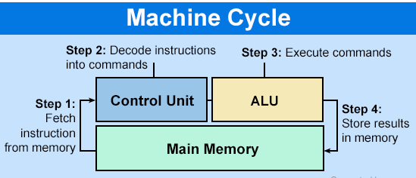
Machine cycle
The steps performed by the computer processor for each machine language instruction received.
The machine cycle is a four-process cycle that includes reading and interpreting the machine language, executing the code, and then storing that code.

Slide 17
Four steps of the machine cycle
Fetch - Retrieve an instruction from memory.
Decode - Translate the retrieved instruction into computer commands.
Execute - Execute the computer commands.
Store - Send and write the results back in memory.

Slide 18
Registers
Registers are special memories within the CPU for holding instructions and data.
Registers are small amounts of high-speed memory contained within the CPU
They are used by the processor to store small amounts of data that are needed during processing, such as: the address of the next instruction to be executed. the current instruction being decoded.

Slide 19
Special Function Registers
registers | Purpose
Program Counter (PC) | Holds the address of the next instruction to be executed.
Accumulator (ACC) | Stores the results from calculations
Memory Address Register (MAR) | Holds the address of a location that is to be read from or written to.
Memory Data Register (MDR) | Temporarily stores data that has been read or data that needs to be written.
Current Instruction Register (CIR) | Holds the current instruction being executed, divided up into operand and opcode.
IR - Instruction Register | Holds the fetched instruction for execution

Slide 20
Instruction Set Architecture
What Is an Instruction Set Architecture?
The ISA acts as an interface between the hardware and the software, specifying both what the processor is capable of doing as well as how it gets done.
An Instruction Set Architecture (ISA) is part of the abstract model of a computer that defines how the CPU is controlled by the software.

Slide 21
The ISA defines the supported data types, the registers, how the hardware manages main memory, key features (such as virtual memory), which instructions a microprocessor can execute, and the input/output model of multiple ISA implementations.
The ISA can be extended by adding instructions or other capabilities, or by adding support for larger addresses and data values.

Slide 22
We shall now look at what are the different features that need to be considered when designing the instruction set architecture.
They are:
Types of instructions (Operations in the Instruction set):
Types and sizes of operands
Addressing Modes(Mode by which the address of an operation is specified)
Addressing Memory(s a reference to a specific memory location used at various levels by software and hardware. )
Encoding and Instruction Formats(Instruction format is defined as machine instruction format that CPU can directly decode and execute)
Compiler related issues

Slide 23
First of all, you have to decide on the types of instructions, i.e. what are the various instructions that you want to support in the ISA.
The tasks carried out by a computer program consist of a sequence of small steps, such as multiplying two numbers, moving a data from a register to a memory location, testing for a particular condition like zero, reading a character from the input device or sending a character to be displayed to the output device, etc.

Slide 24
A computer must have the following types of instructions:
Data transfer instructions
Data manipulation instructions
Program sequencing and control instructions / Program control instructions
Input and output instructions

Slide 25
Data transfer instructions: perform data transfer between the various storage places in the computer system, registers, memory and I/O.
Since, both the instructions as well as data are stored in memory, the processor needs to read the instructions and data from memory. After processing, the results must be stored in memory.
Therefore, two basic operations involving the memory are needed, namely, Load (or Read or Fetch) and Store (or Write).

Slide 26
The Load operation transfers a copy of the data from the memory to the processor and the Store operation moves the data from the processor to memory.
Other data transfer instructions are needed to transfer data from one register to another or from/to I/O devices and the processor.

Slide 27
b. Data manipulation instructions: perform operations on data and indicate the computational capabilities for the processor.
These operations can be arithmetic operations, logical operations or shift operations.
Arithmetic operations include addition (with and without carry), subtraction (with and without borrow), multiplication, division, increment, decrement and finding the complement of a number. The logical and bit manipulation instructions include AND, OR, XOR, Clear carry, set carry, etc. Similarly, you can perform different types of shift and rotate operations.

Slide 28
c. Program sequencing and control instructions / Program control instructions
We generally assume a sequential flow of instructions.
Instruction sequencing: is the order in which the instructions in a program are carried out.
That is, instructions that are stored in consequent locations are executed one after the other.
However, you have program sequencing and control instructions that help you change the flow of the program.
This is best explained with an example. Consider the task of adding a list of n numbers.

Slide 29
d. Input and Output instructions
Are used for transferring information between the registers, memory and the input / output devices.
It is possible to use special instructions that exclusively perform I/O transfers, or use memory – related instructions itself to do I/O transfers.

Slide 30
Architecture and micro-architecture
Architecture does not tell you how a processor is built or how it works.
Architecture of Microprocessor: Its architecture consists of a central processing unit, memory modules, a system bus, and an input/output unit.
The system bus connects the various units to facilitate the exchange of information. It further consists of data, address, and control buses to perform data exchanging properly.
The build and design of a processor is referred to as micro-architecture. Micro-architecture tells you how a particular processor works.

Slide 31
Microarchitecture: is the logical representation of how a microprocessor is designed so that the interconnections between components – the control unit, the arithmetic logic unit, registers and others.
This includes how buses, the data pathways between components, are laid out to dictate the shortest paths and proper connections.

Slide 32
Systems architecture refers to the structure of the internal components of a computer system
Modern computers often involves: a processor; a memory unit, which stores both instructions and data; connections for input and output devices; and secondary storage for data.

Slide 33
Rates & Data Transfer:
What characterizes a computer processor is its speed or rate - how fast it can execute instructions.
As of now, speed is measured in gigahertz (GHz).
Some CPU rates are 2.0 GHz, 2.40 GHz, 3.20 GHz, ……….
Because the CPU greatly determines the overall performance of a PC, the type of processor and its speed are two of the main factors to look for when deciding to buy a computer.
But keep in mind there are other important things, such as the amount of memory.

Slide 34
The more data a computer can handle means improved performance.
The amount of memory supported by a processor is also determined by the number of bits.
Types of Intel Pentium family of Microprocessors:
The Pentium is a widely-used personal computer microprocessor from the Intel Corporation.
Newer CPU’s can process more instructions at a time.
The CPU generations include 8080, 80286, 80386, 80486, Pentium(586), Pentium Pro(686)- ,Pentium 1, Pentium 11, Pentium 111, Pentium IV.

Slide 35
Different processors:
Classic Pentium
Pentium MMX
Pentium Pro
Pentium II
Celeron
Pentium II Xeon
Pentium III
Pentium III Xeon
……………….

Slide 36
Factors Affecting CPU Performance
There are many factors that affect processor performance.
Understanding some of these factors will help you make the proper choices when designing your homebuilt computer.
The most important factors affecting processor performance are:

Slide 37
Instruction Set
This is the processor's built-in code that tells it how to execute its duties.
An instruction is a set of codes that the computer processor can understand.
A set of codes that can only be understood by a processor of the computer or CPU is known as an instruction set.
It's something that's coded into the chip when it's manufactured and that you can't change.
But together with processor architecture, it does affect performance across a given line of CPU's. The processor's architecture and instruction set determine how many cycles are needed to execute a given instruction.
In other words, some instruction sets are more efficient than others, enabling the processor to do more useful work at a given speed.

Slide 38
Clock Speed
The clock speed (or clock rate) is stated in megahertz (MHz) or gigahertz (GHz), and refers to the speed at which the processor can execute instructions.
The faster the clock, the more instructions the processor can complete per second.
But as mentioned previously, the efficiency of the processor's architecture determines how much actual work a processor can do with the same number of cycles.
The clock speed measures the number of cycles your CPU executes per second, measured in GHz (gigahertz). In this case, a “cycle” is the basic unit that measures a CPU's speed.

Slide 39
Word size
An important characteristic of a processor is its word size.
This is the number of bits that the CPU can work with in any one clock cycle.
The more bits it can work with in one clock cycle, the faster the computer will go.
Word "size" refers to the amount of data a CPU's internal data registers can hold and process at one time.

Slide 40
Bandwidth
Measured in bits, the bandwidth determines how much information the processor can process in one instruction.
If you were to compare data flow to the flow of traffic on a highway, then clock speed would be the speed limit, and bandwidth would be the number of lanes on the highway.
The current bandwidth standard for desktop and laptop PC's is 64 bit. 32-bit is officially a thing of the past.

Slide 41
Thank you for your kind attention!!
END OF CHAPTER THREE!!!

